Slide 1


WELCOME
Project :
Virtual Piano
DEVELOPERS:
GURPREET SINGH
RAJVANSH SINGH
SUJAY MANN

Slide 2
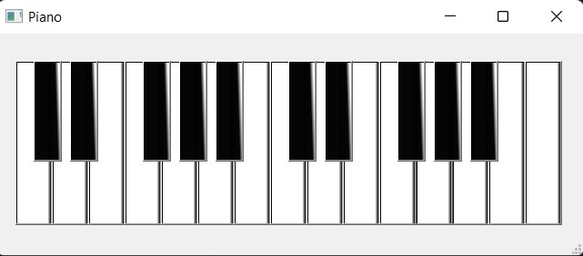
ABOUT :
What is virtual piano:
A virtual piano is an software designed to simulate playing a piano on a computer. The virtual piano is played using a keyboard and/or mouse and typically comes with many features found on a digital piano.
It can simulate music files, highlight the piano keys corresponding to the notes and highlight the sheet music notes

Slide 3
libraries :
PyQt5
Threading
Play sound
Using QtCore, QtWidgets for forming gui
Using thread for bind the sound
Using it for play the sounds

Slide 4
MOTIVE
To provide the virtual feel of the piano
Learn from home as per your comfort
Budget friendly
Learning with enjoyment
You can learn anytime of our day as per your schedule
You can track your progress of the learning
It is based on the virtual so it is very convenient to use by the laptop keys
enable you to play the piano instantly,

Slide 5

BINDING
It this projects we try to bind the keys of the laptop with the notes of the Piano by providing
the sounds to that key . The threading module is used to thread the sound with the keys and
Playsound module is used to play the wav music files of the particular note .
c40 d40 f40 g40 a40 c50 d50 f50 g50 a50
C4
D4
E4 F4 G4 A4 B4 C5 D5 E5 F5 G5 A5 B5

Slide 6
SOUNDS
 | Piano key | Laptop key | Piano key | Laptop key
1 | C4 | Q | C5 | C
2 | C40 | 2 | C50 | F
3 | D4 | W | D5 | V
4 | D40 | 3 | D50 | G
5 | E4 | E | E5 | B
6 | F4 | R | F5 | N
7 | F40 | 5 | F50 | J
8 | G4 | T | G5 | M
9 | G40 | 6 | G50 | K
10 | A4 | Y | A5 | ,
11 | A40 | 7 | A50 | L
12 | B4 | U | B5 | .
There are 24 keys of the piano at the initial state of the project .

Slide 7
FUTURE
Virtual Piano is a digital product designed for the future. Anyone can access and play the Virtual Piano in less than 1 minute from their computer, mobile or tablet. It takes no space in your living room because it lives in the cloud and your free music sheets and song performance data is also stored there.

Slide 8
Thank you

